Slide 1
What is R.E?
Mrs Buckler’s assembly

Slide 2
R.E stands for…
Religious Education

Slide 3
Religious Education…
What does this mean?

Slide 4
Religious Education is…
Religious Education (RE) aims to help develop pupils' knowledge of the world's principal religious traditions and worldviews and promote tolerance and understanding.

Slide 5
Religious Education is…
If we understand more about the beliefs, traditions and customs that people in the world have then we can respect and get on with people more.

Slide 6

Religious Education is…

Slide 7
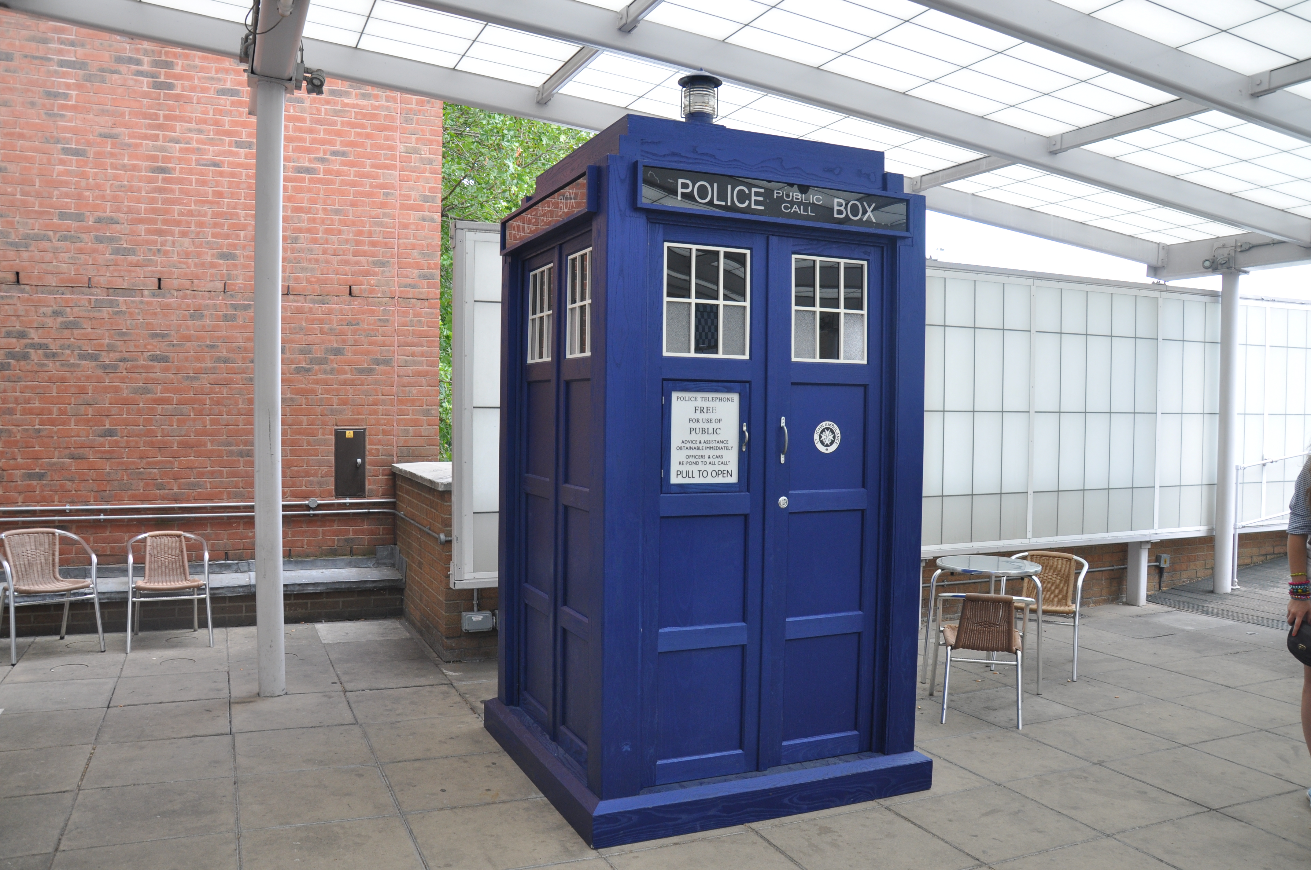
RE is like the Tardis

Slide 8
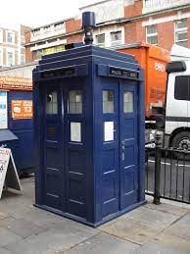
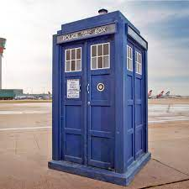
RE is like the Tardis
It may look small form the outside but it makes you think big

Slide 9
How do we learn in RE?

Slide 10

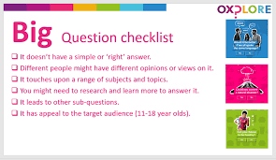
Ask Big questions

Slide 11
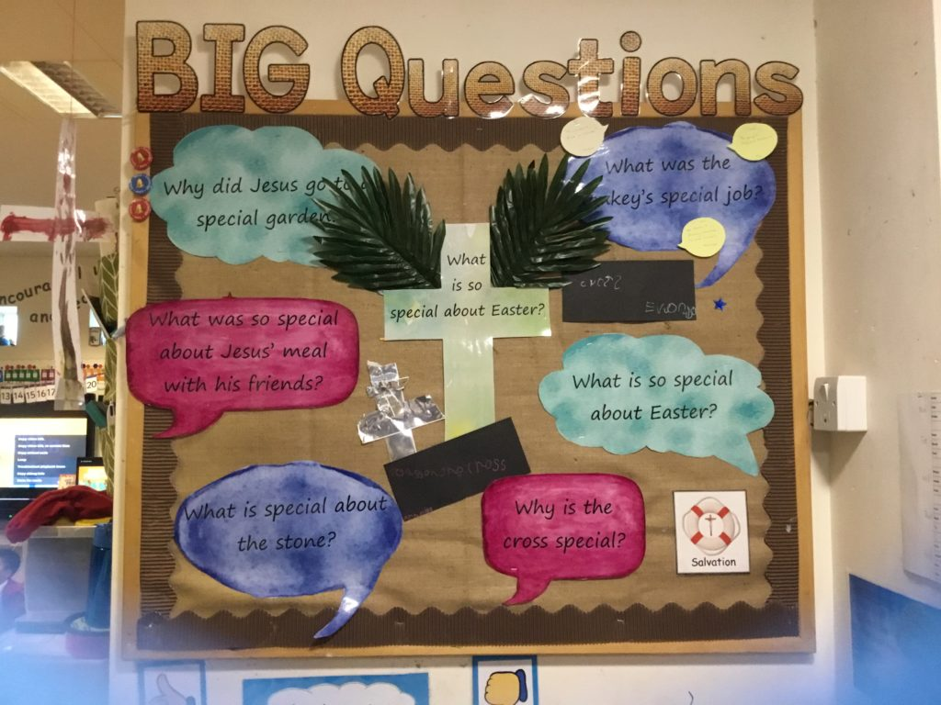
Big Questions

Slide 12
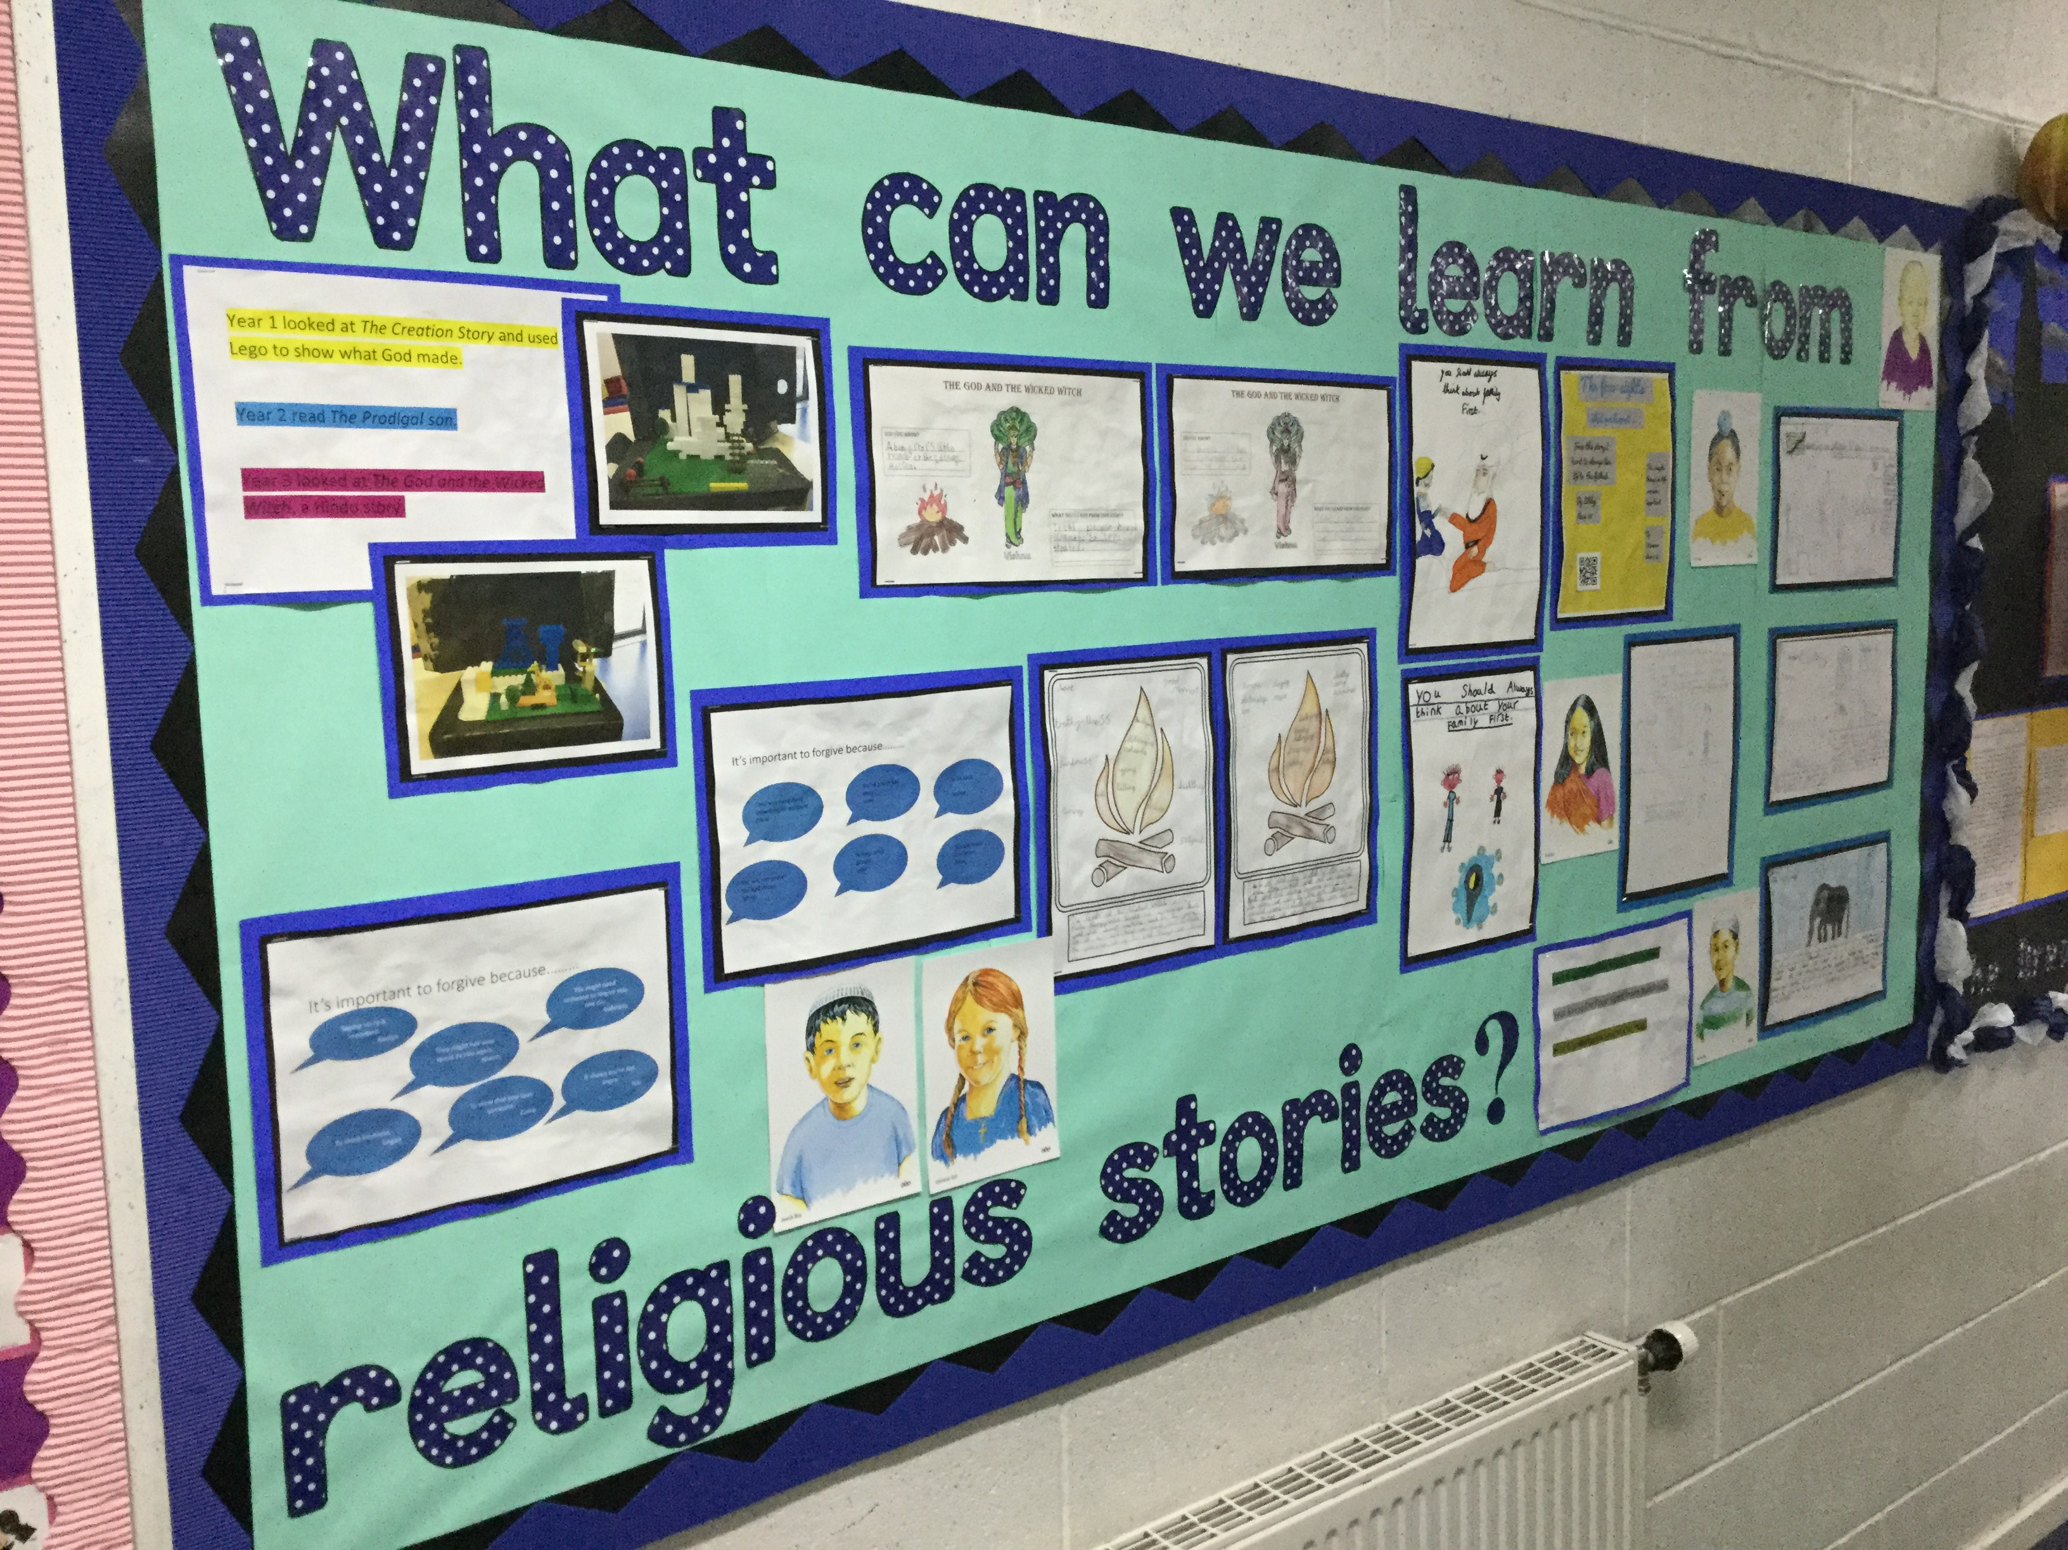
Big Questions

Slide 13
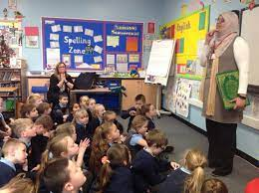

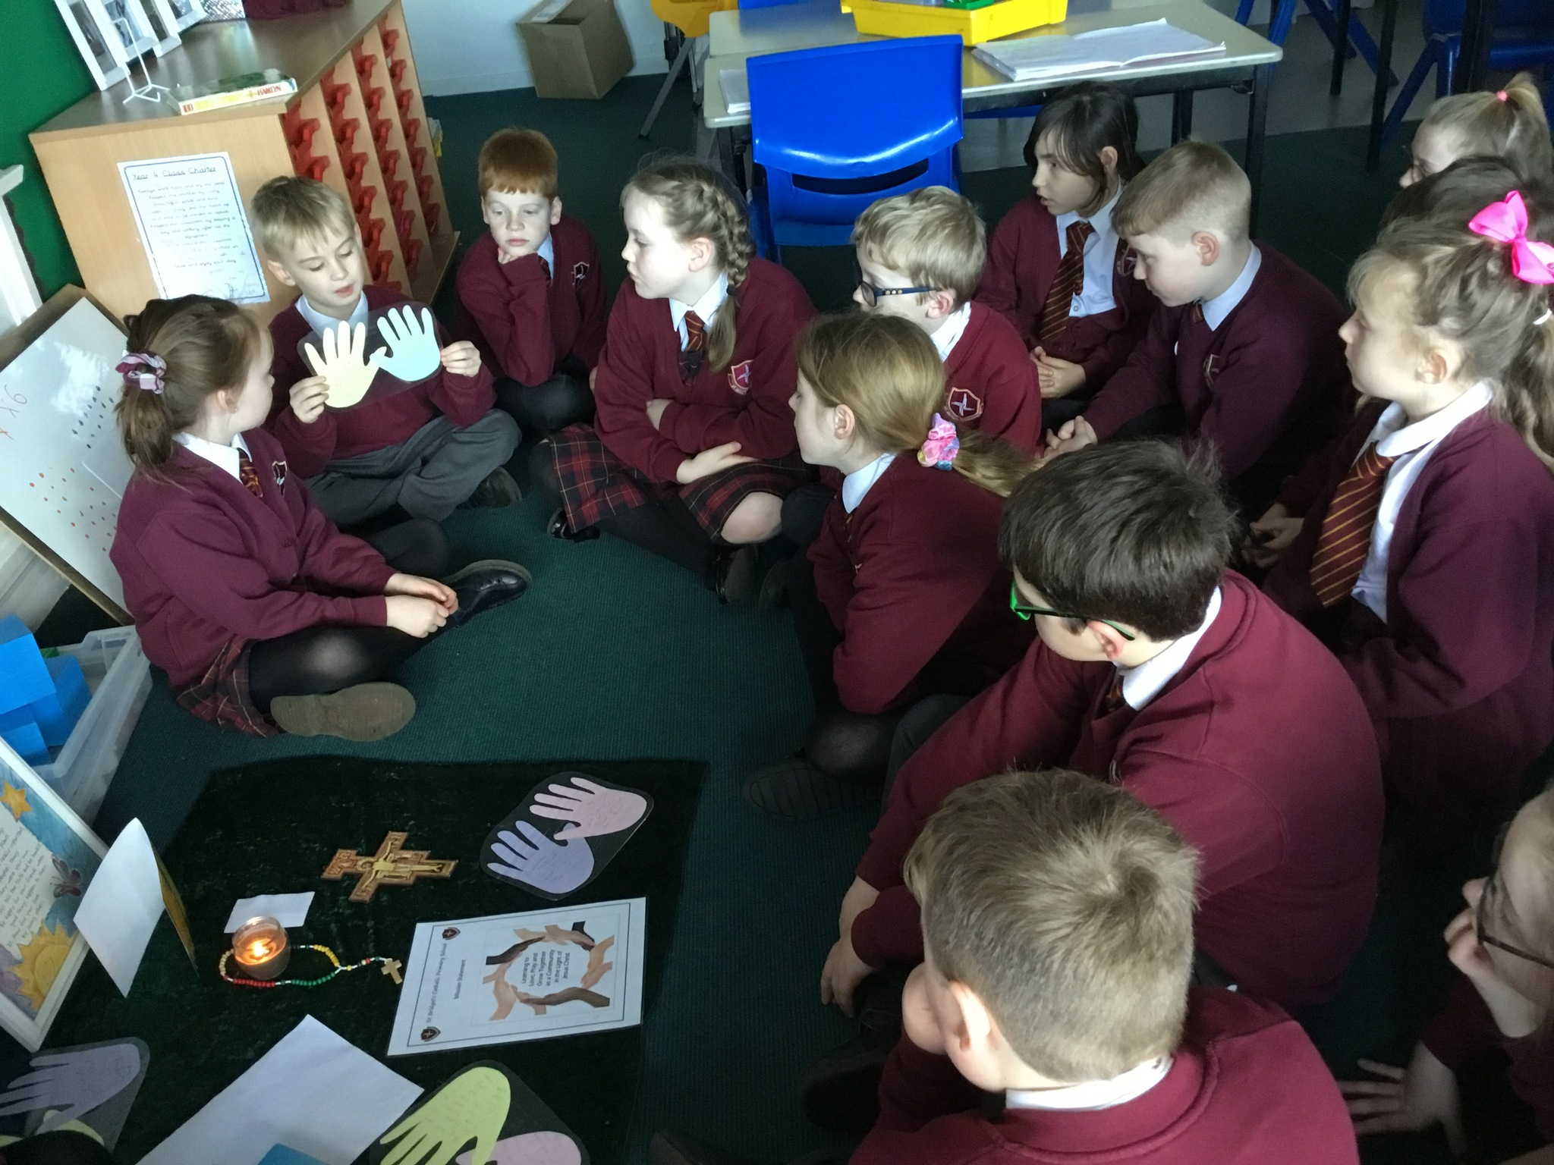
Big talk…
Communicate our ideas

Slide 14
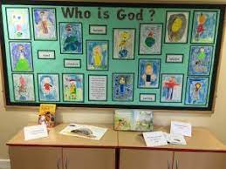
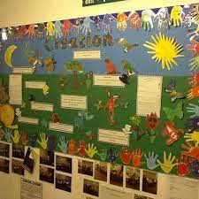
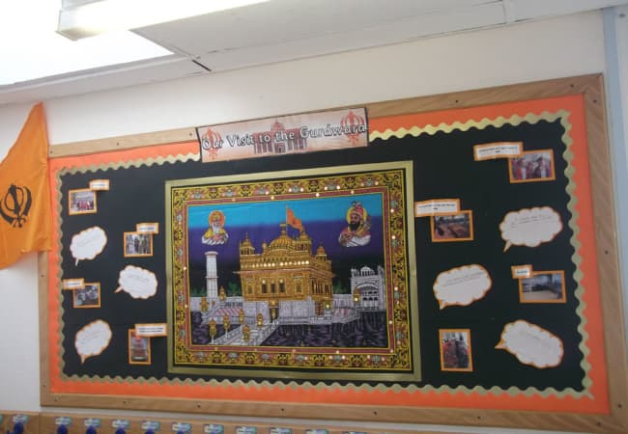
Display our ideas

Slide 15
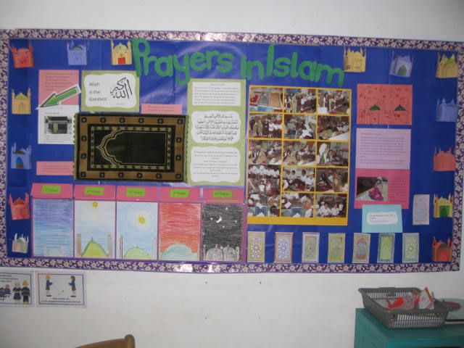
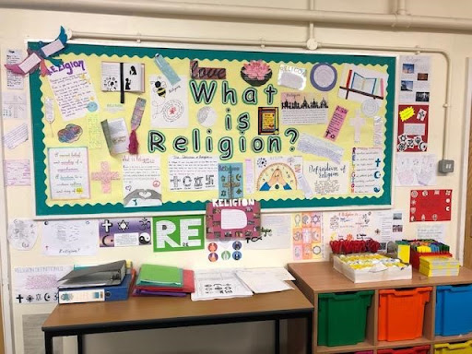
Challenge our wrong ideas

Slide 16
What do we learn about in R.E?
The religions of the world

Slide 17
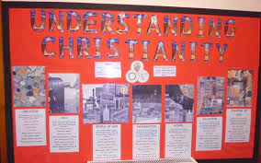
What do we learn about in R.E?

Slide 18
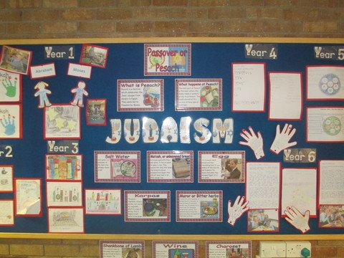

Slide 19
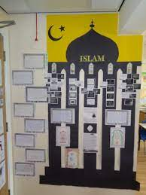
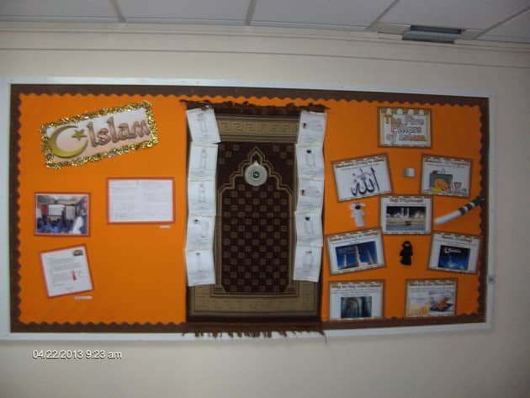
Islam

Slide 20
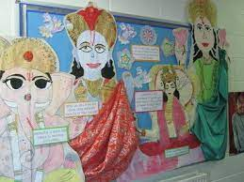
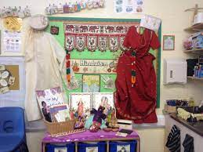
Hinduism

Slide 21
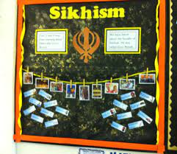

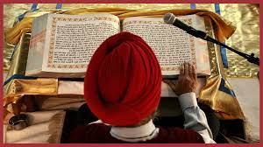
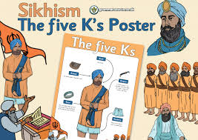
Sikhism

Slide 22
what else do we learn about?
How the world was created?
How important prayer is?
The special places where people go to worship God
World festivals and celebrations
Why people can dedicate their life to doing good

Slide 23
Why is R.E important?
It is important for our children & young people to learn to be respectful of both their own and other people's beliefs & cultures. This helps make schools & communities a fairer place for everybody, whatever their religion, culture, language or background.
.

Slide 24
If I enjoy RE what career could I have
..
Activist.
Administrative Coordinator.
Author.
Charity Coordinator.
Child & Youth Worker.
Clergyperson.
Community Center Director.
Community Developer.

Slide 25
Websites to learn more http://www.bbc.co.uk/schools/websites/4_11/site/re.shtml http://www.bbc.co.uk/education/subjects/z7hs34j http://www.reonline.org.uk/bbc-learning-zone-class-clips-praying-at-the-mosque/ https://request.org.uk/ http://www.dltk-bible.com/%5C/genesis/chapter15-cv.htm http://biblehub.com/childrens/ http://www.topmarks.co.uk/Search.aspx?Subject=25 http://pof.reonline.org.uk/ http://www.bbc.co.uk/schools/websites/4_11/site/re.shtml

